Slide 1
React

Slide 2

Babel
Compile JSX(JavaScript XML) to JavaScript

Slide 3
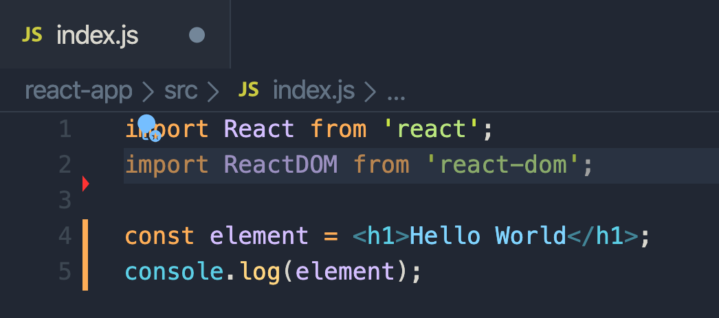
Create index.js

Slide 4

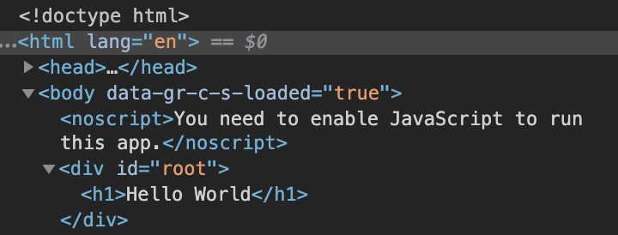
Show this component

Slide 5

Install Bootstrap

Slide 6
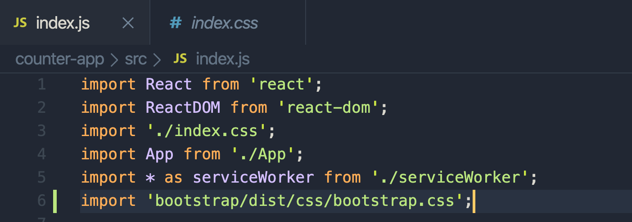
Import Bootstrap css

Slide 7
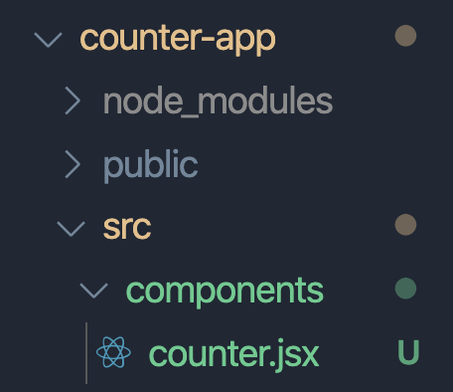
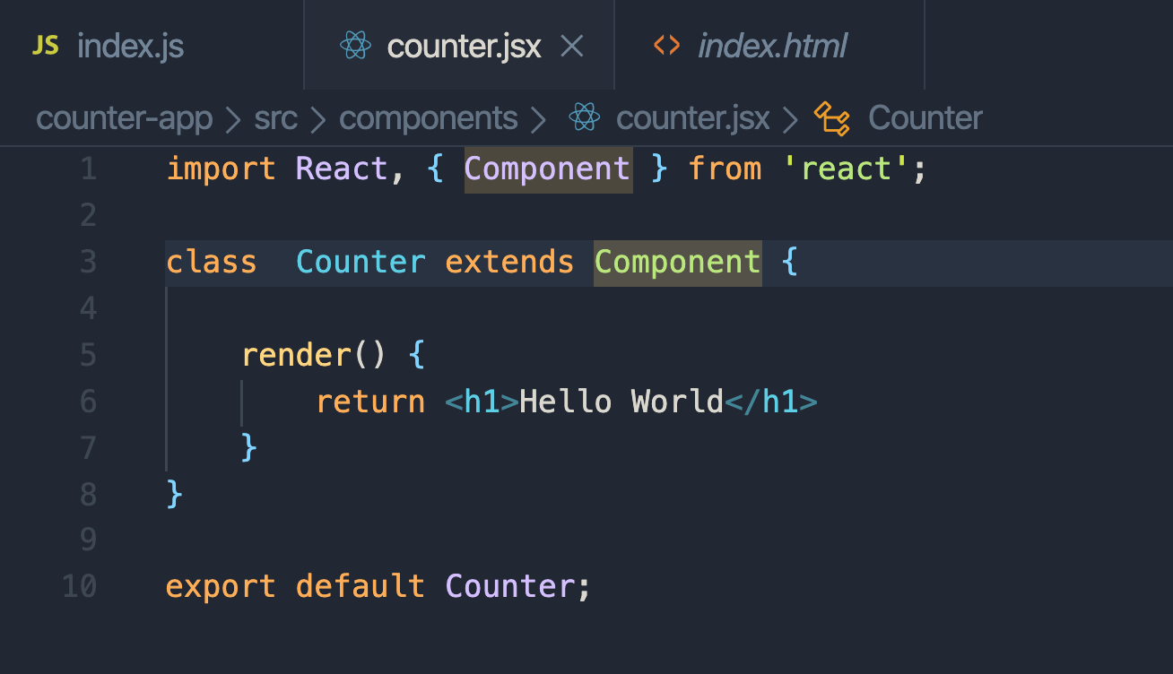
Use snippet to create counter.jsx
imrc = Import React Component
cc = Class Component

Slide 8
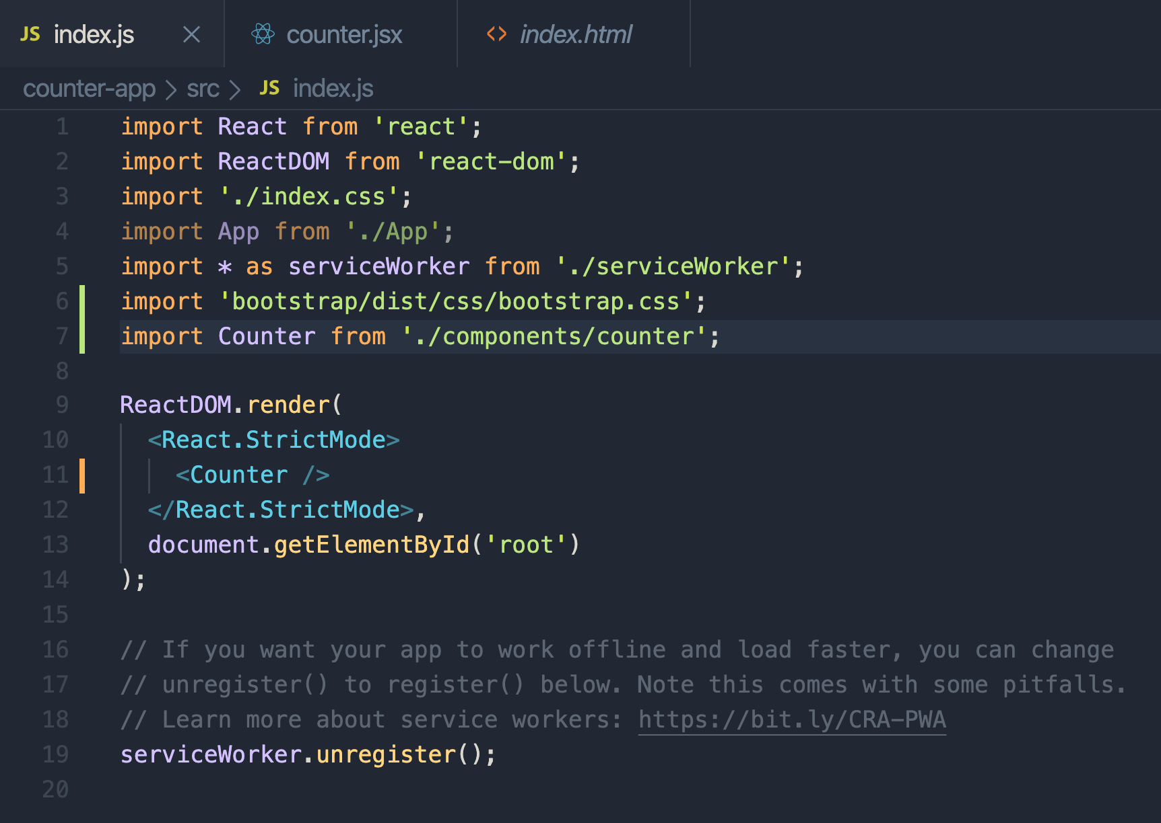
Import Counter class

Slide 9
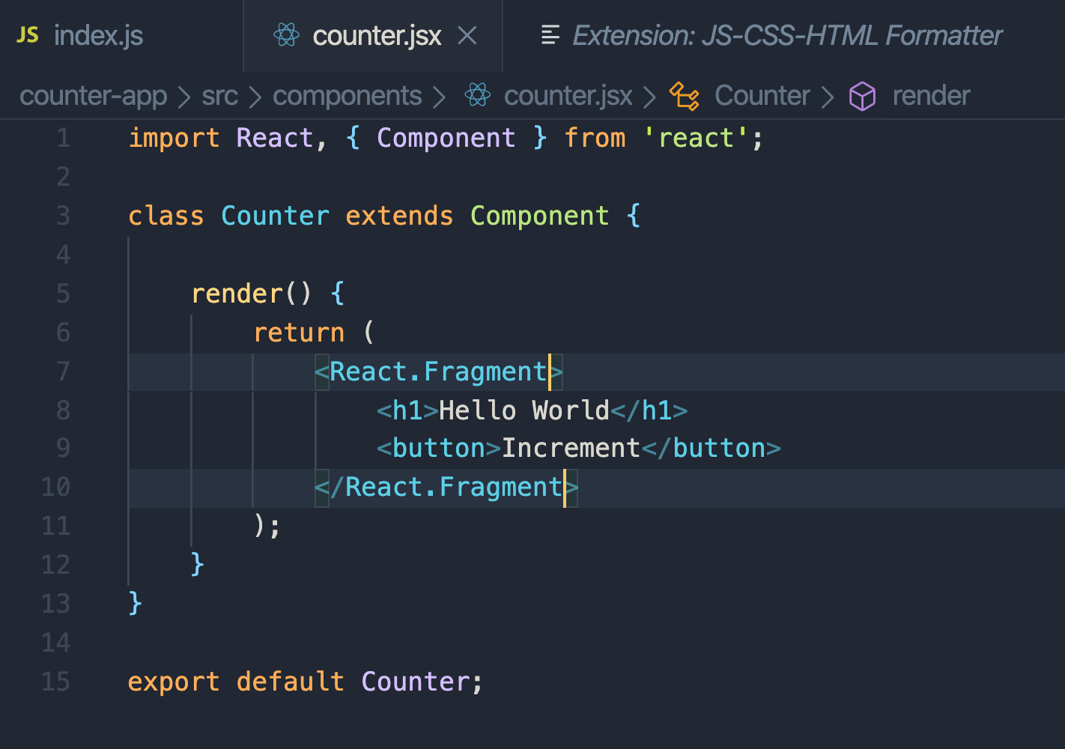

Create a button(put every element in one )

Slide 10
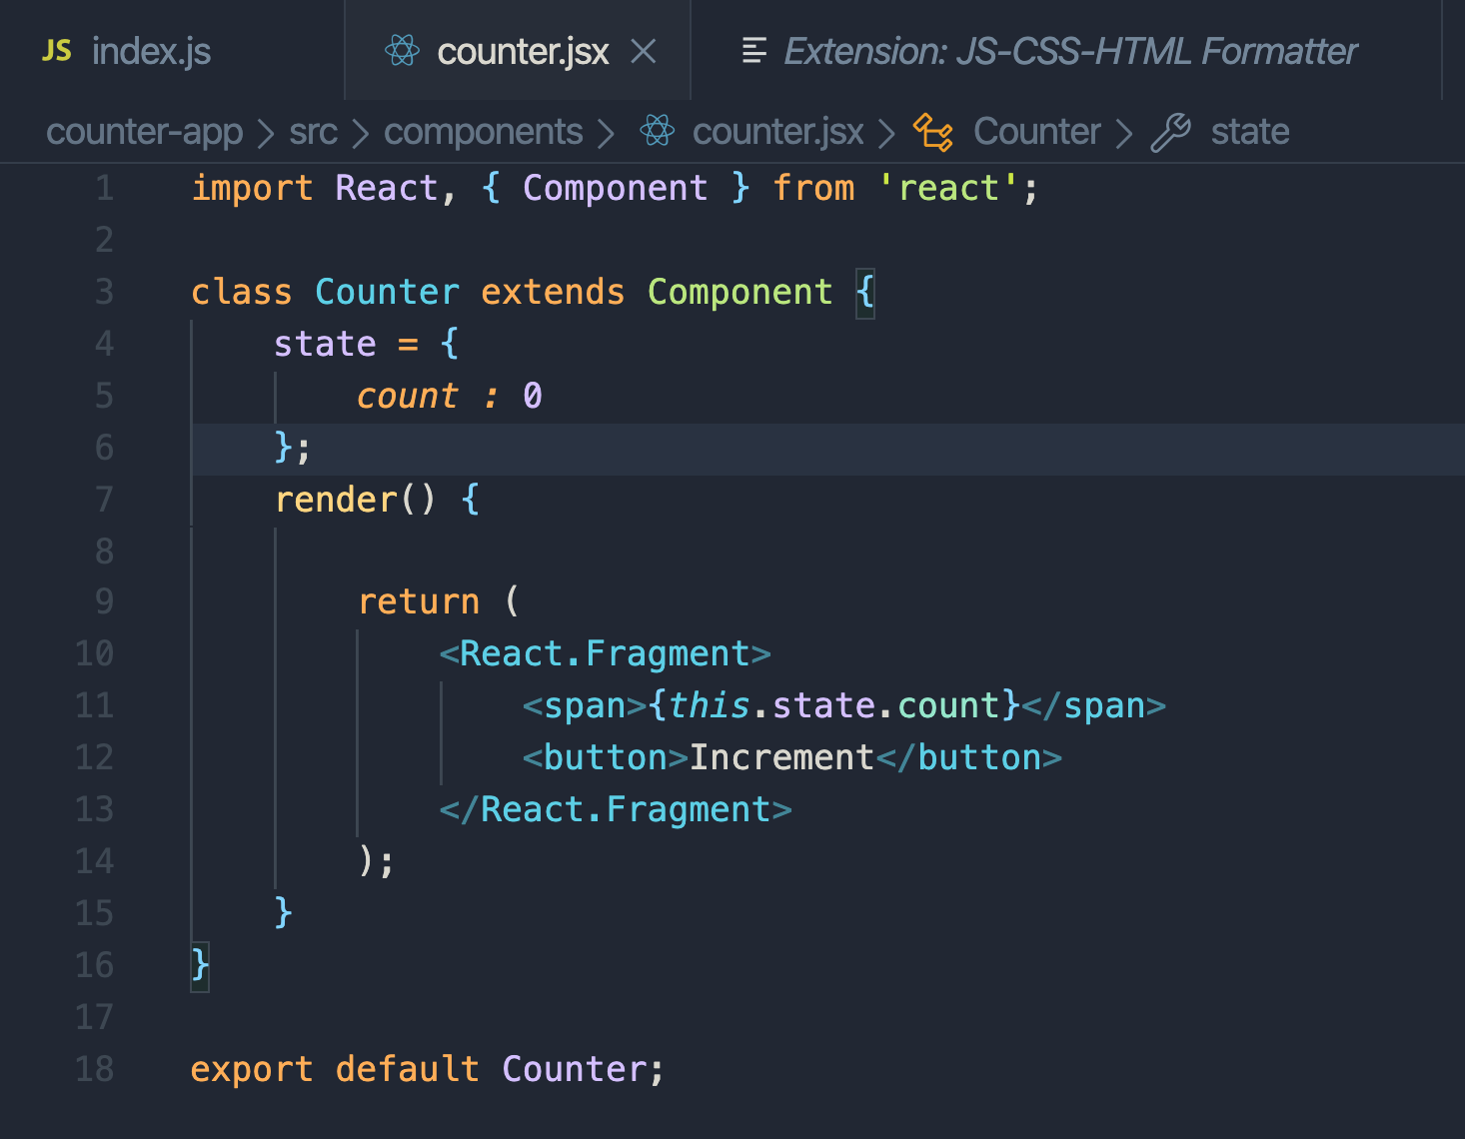
Dynamic State

Slide 11
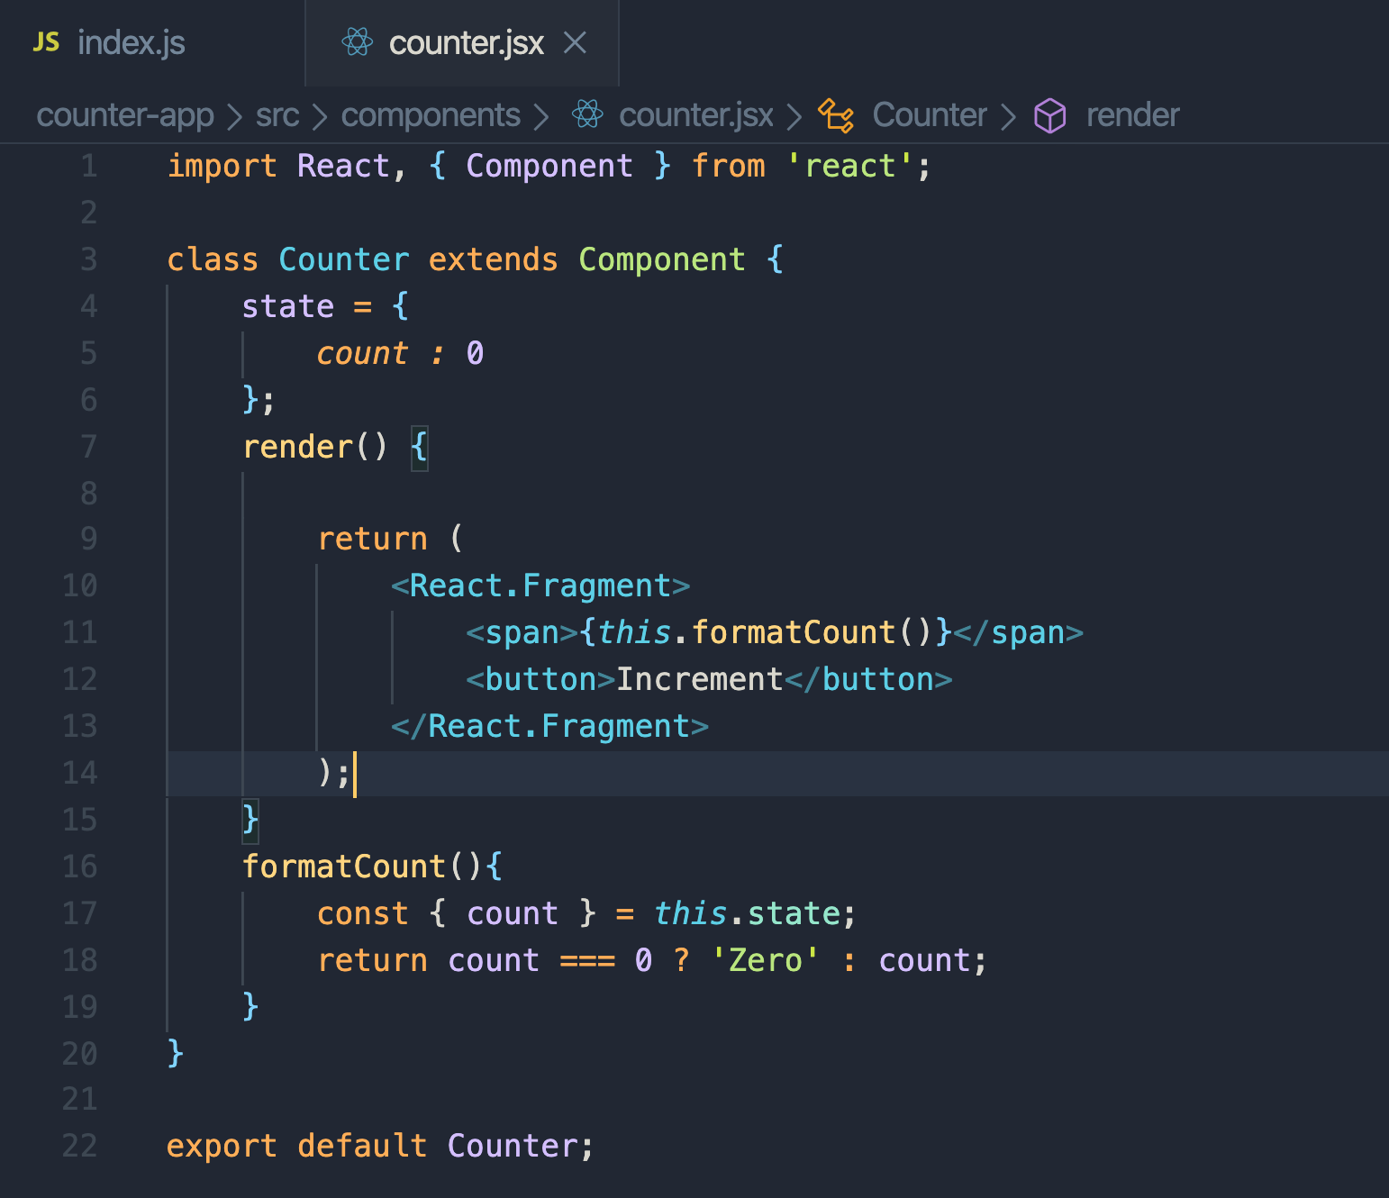
Create function()

